Slide 1


PROJECT TITLE: AI-POWERED HOSPITAL MANAGEMENT SYSTEM
DEPARTMENT OF CSE-AIML (CSM) – IV-II Sem
Project Review - 0
Batch #:16
Project Guide:
Mrs. N Nalini Krupa,
Associate Professor,
Dept. of CSM,
VVIT
Team Members (Regd #) : IV -II : CSM - B
1. 21BQ1A4289
2. 22BQ5A4212
3. 21BQ1A4277
4. 21BQ1A4279

Slide 2
PROJECT TITLE:AI-POWERED HOSPITAL MANAGEMENT SYSTEM
DEPARTMENT OF CSE-AIML (CSM) – IV-II Sem
Project Review - 0
Batch #:16
Project Description:
Our project Hospital Management System includes registration of patients, storing their details into the system, and also booking their appointments with doctors.
Our software has the facility to give a unique id for every patient and stores the details of every patient using the id. The Hospital Management System can be entered using a username and password. It is accessible either by an administrator or receptionist. Only they can add data into the database. The data can be retrieved easily. The interface is very user-friendly. The data are well protected for personal use and makes the data processing very fast.
It is having mainly two modules. One is at Administration Level and other one is of user I.e. of patients and doctors. The Application maintains authentication in order to access the application. Administrator task includes managing doctors information, patient’s information. To achieve this aim a database was designed one for the patient and other for the doctors which the admin can access. The complaints which are given by user will be referred by authorities.
The patient modules include checking appointments, prescription. User can also pay doctor’s Fee online.
Project Functional Requirements: (Features):
Provide access to registered users only.
Registration of new patients.
Enable patient to view their record.
Enable patient to update their record.
Generate appointment date and timing.
Confirmation by doctor.
Patients can do payment.
Modification in schedule by patient.
Admin verify Payment and Generate Bill/Receipt.
Admin can view monthly/yearly records.
Live chat AI
User Authentication
Secure password management(hashing) and OTP/email verification.
Searching functionality
Health Tips
Telemedicine integration
Pharmacy management.

Slide 3
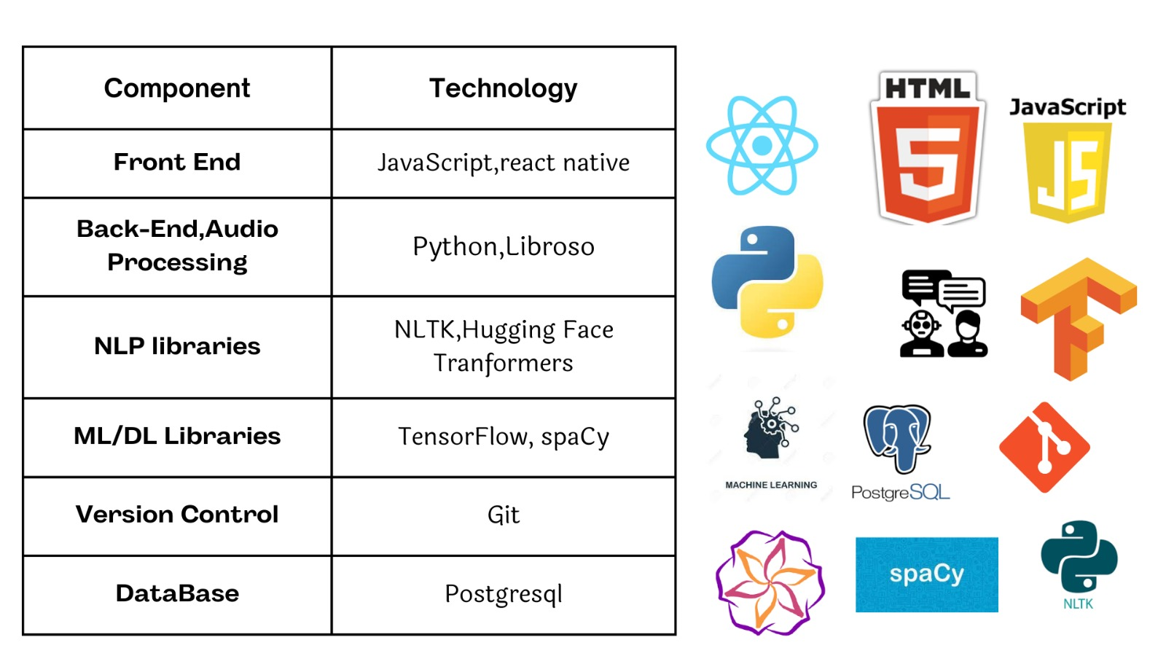

Slide 4
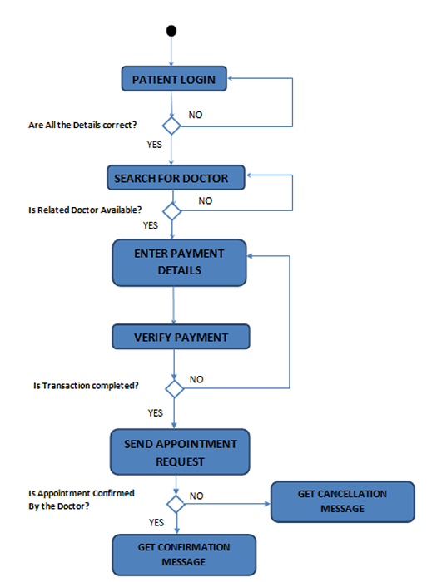

Slide 5
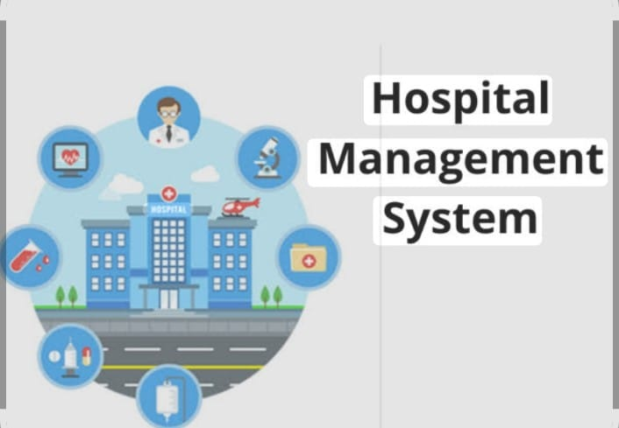
Project Title: ai-powered hospital management system
DEPARTMENT OF CSE-AIML (CSM) – IV-II Sem
Project Review - 0
Batch #:16
Project Tasks -Team member Allocation
Team Member | Features Assigned | Tasks to complete
Nandini Korlakanti | F1 | ***
Noorbasha Seema | F2
Katta Gowri | F3
Amarendranadh | F4

Slide 6

PROJECT TITLE: AI-POWERED HOSPITAL MANAGEMENT SYSTEM
DEPARTMENT OF CSE-AIML (CSM) – IV-I Sem
Project Review - 0
Batch #:16
Project Team member Learning Status:
Team Member | Features | Status
Nandini Korlakanti | Inventory management
Noorbasha Seema | Patient registration
Katta Gowri | Pharmacey management
Amarendranadh | Appointment Scheduling

Slide 7
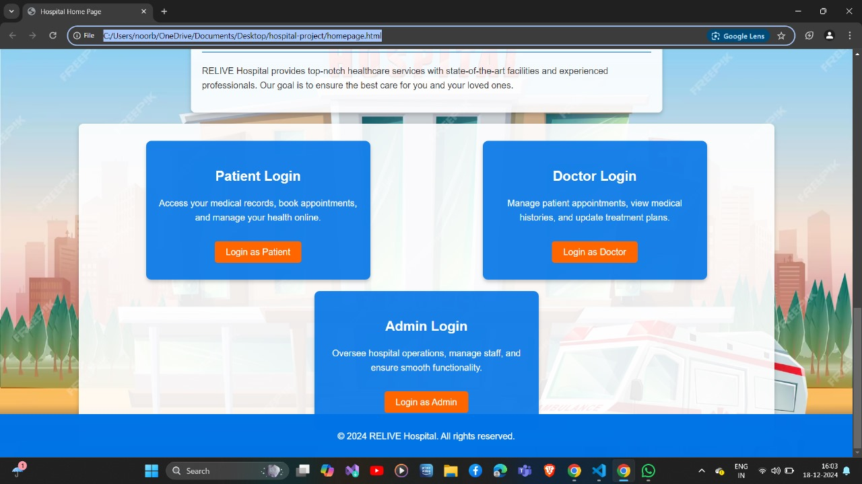
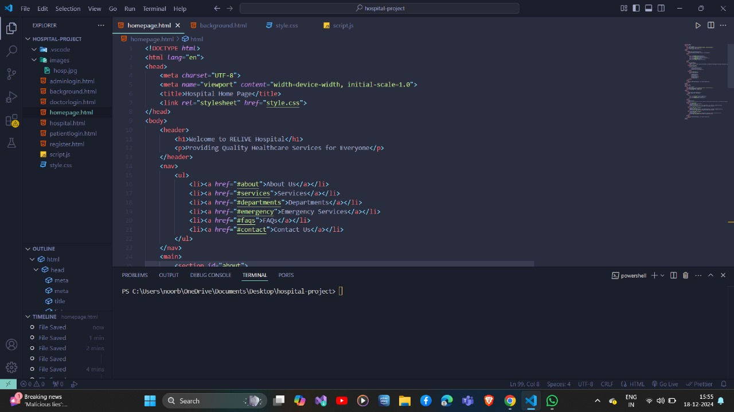
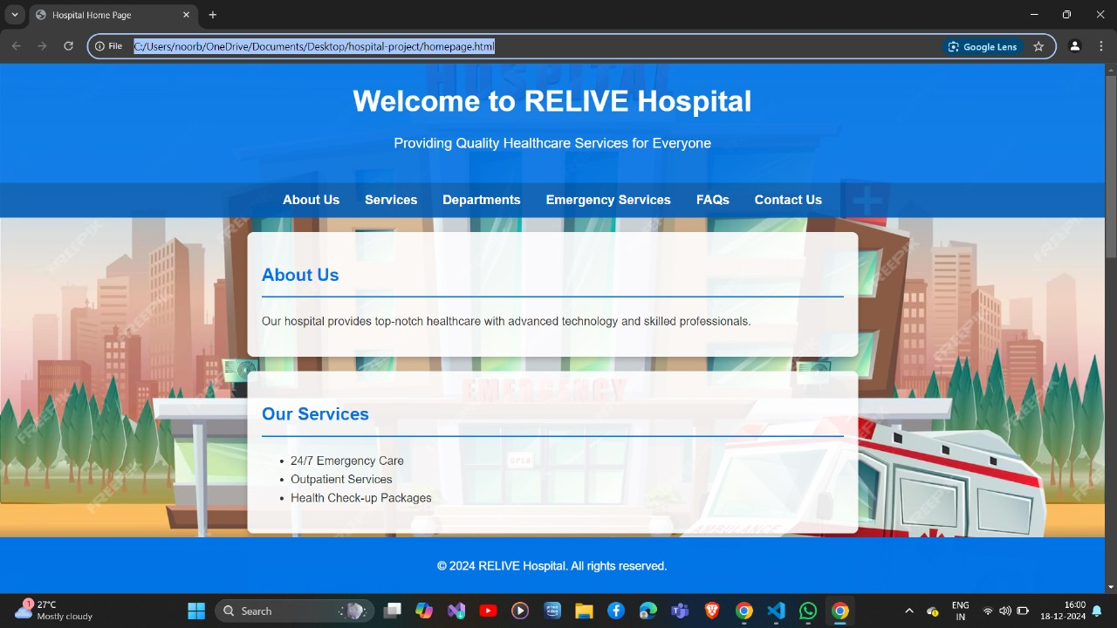
PROJECT TITLE: AI-POWERED HOSPITAL MANAGEMENT SYSTEM
DEPARTMENT OF CSE-AIML (CSM) – IV-II Sem
Project Review - 0
Batch #:16
Project Tasks –Implementation Status Screen Shots & <<Code Ready>>

Slide 8


